Slide 1
Android Internals - The Android Nfc stack
Diegem, 23 November 2015
Jeroen Peelaerts

Slide 2
Android internals - The Android NFC stack
Device modding + ROM Cooking
Introduction to NFC technologies (Mifare)
Status of NFC on Android
POC presentation
Possibilities for the future

Slide 3
Device modding - Rooting your device
Required to install custom ROMs
Gain superuser privileges
su binary on /system with correct set-uid permissions (run as root)
Run special apps (that require root)
Wifi tethering apps
Overclocking (set governors, io schedulers)
Ad blocking (/etc/hosts file on /system)
Full control over device
Tweak system
Remove bloatware - KingRoot (temp root)
Get latest android updates
Leaves device unsecured!
Possibly expose user data to apps
Use encryption to secure data
Use SuperSu to manage apps requesting root
Be aware of possible consequences
Notes:
Question: Who has is using a rooted device here?
Question: Who has installed custom ROMs?
XDA: number of actions needed which are a bit overwhelming at first
set-uid: set user id upon execution

Slide 4
Device modding + ROM Cooking - Partition layout
Partition layout of the NAND flash
boot loader
recovery (/recovery)
radio - baseband image - serial device in /dev
system (/system)
userdata (/data)
boot (/boot) -> initrd + zImage
Write access to boot and system partitions required
Bootloader unlock
Cannot flash or boot unsigned images
Developer portal (voids warranty) 'fastboot oem unlock`
Byte patching of the bootloader `echo -ne "HTCU" | dd of=/dev/block/mmcblk0p2 bs=1 seek=33796`
Install or boot custom recovery (TWRP)
Install su on /system
Modify existing stock image and add su binary

Slide 5
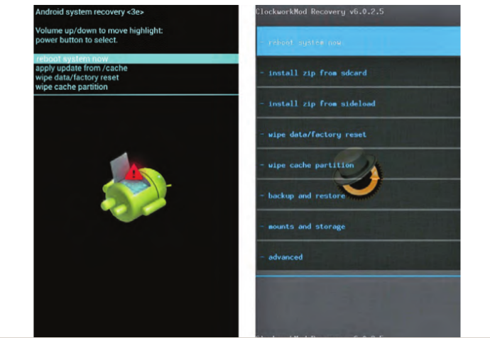
Device modding + ROM Cooking - Custom recovery

Slide 6
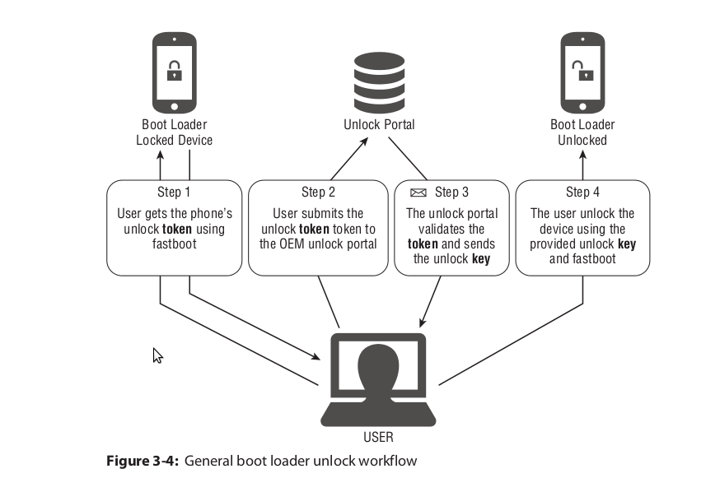
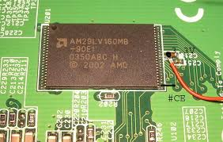
Device modding + ROM Cooking - Bootloader constraints (2)
What if manufacturer doesn’t allow unlock?
eg. NAND flash locks: HTC S-On and S-Off
Flash lock that disables writing to partitions (signal applied to the flash chip)
Toggle security flag in the radio NVRAM (read by a kernel module)
Flash a patched bootloader (HBOOT) by combining several exploits
Official way: fastboot flash unlocktoken Unlock_code.bin
Use a custom exploit
BruCon talks
zergRush
Ashmem exploits
Symbolic links vuln
Notes:
Ashmem exploit: remap existing memory for init process. In this case local.prop (global properties store) location could be remapped for the init process, giving control to the end user to modify it
Symbolic links: init.rc disk containing mkdir chmod 0771

Slide 7
Device modding + ROM Cooking - Building AOSP
Look for device support in AOSP.
Manufacturer needs to release code first
Eases development or modification of system components
Generate debug symbols for debugging native android applications
Increases binary size significantly
Complete build system for the whole android ecosystem (sdk, tools, ..)
Cyanogenmod = based on AOSP
Aftermarket support for your device
About 25gig of code for one device build
Uses repo tool to manage multiple git repositories
Developers can contribute, review patches and check latest commits upstream
Downside: stability, not a lot of testing or quality assurance
Full build easily takes half a day
Partial build might be a better option here
Sync using `adb sync system/`
remove some unneeded projects in a local_manifest.xml
Notes:
Toon remove-project statements in local_manifest.xml

Slide 8
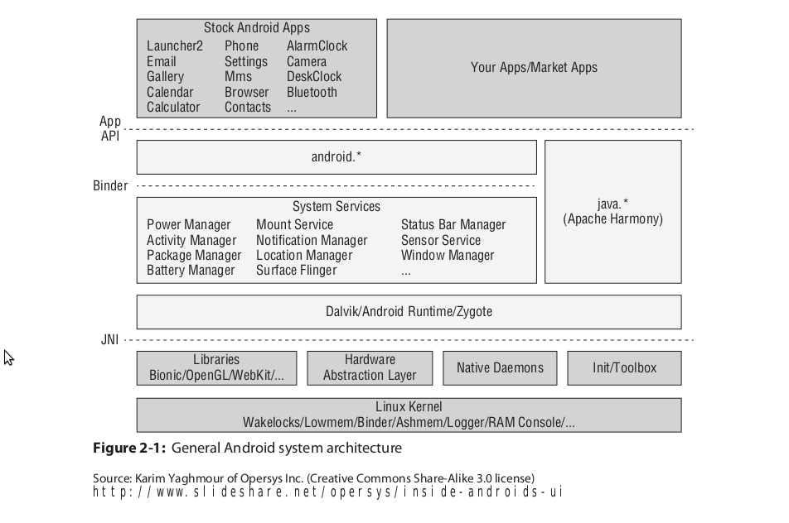
Device modding + ROM Cooking - AOSP overview
Notes:
Toon remove-project statements in local_manifest.xml

Slide 9
Introduction to NFC technologies
Nfc has many different incompatible implementations
13.65Mhz or 125Khz (RFID)
Lots of different incompatible ‘standards’
Mifare (Classic, Ultralight, Desfire), Calypso (Mobib), Felica, ..
This talk: Mifare Desfire EV1
Stored value card.
4K or 8k memory, cryptographic functionality
Considered a secure solution
Directory / File based structure
Legacy versions (<v0.6) only supports DES and 3K3DES.
Communication modes
native, wrapped and iso commandsets
CLA / INS / P1 / P2 / P3 / Lc / DATA / Le
command style is chosen at the beginning of the session
completely encrypted communication, data + MAC or plain bytes
Tools for interaction
libnfc (PN532), libfreefare
Notes:
13Mhz applications have more

Slide 10
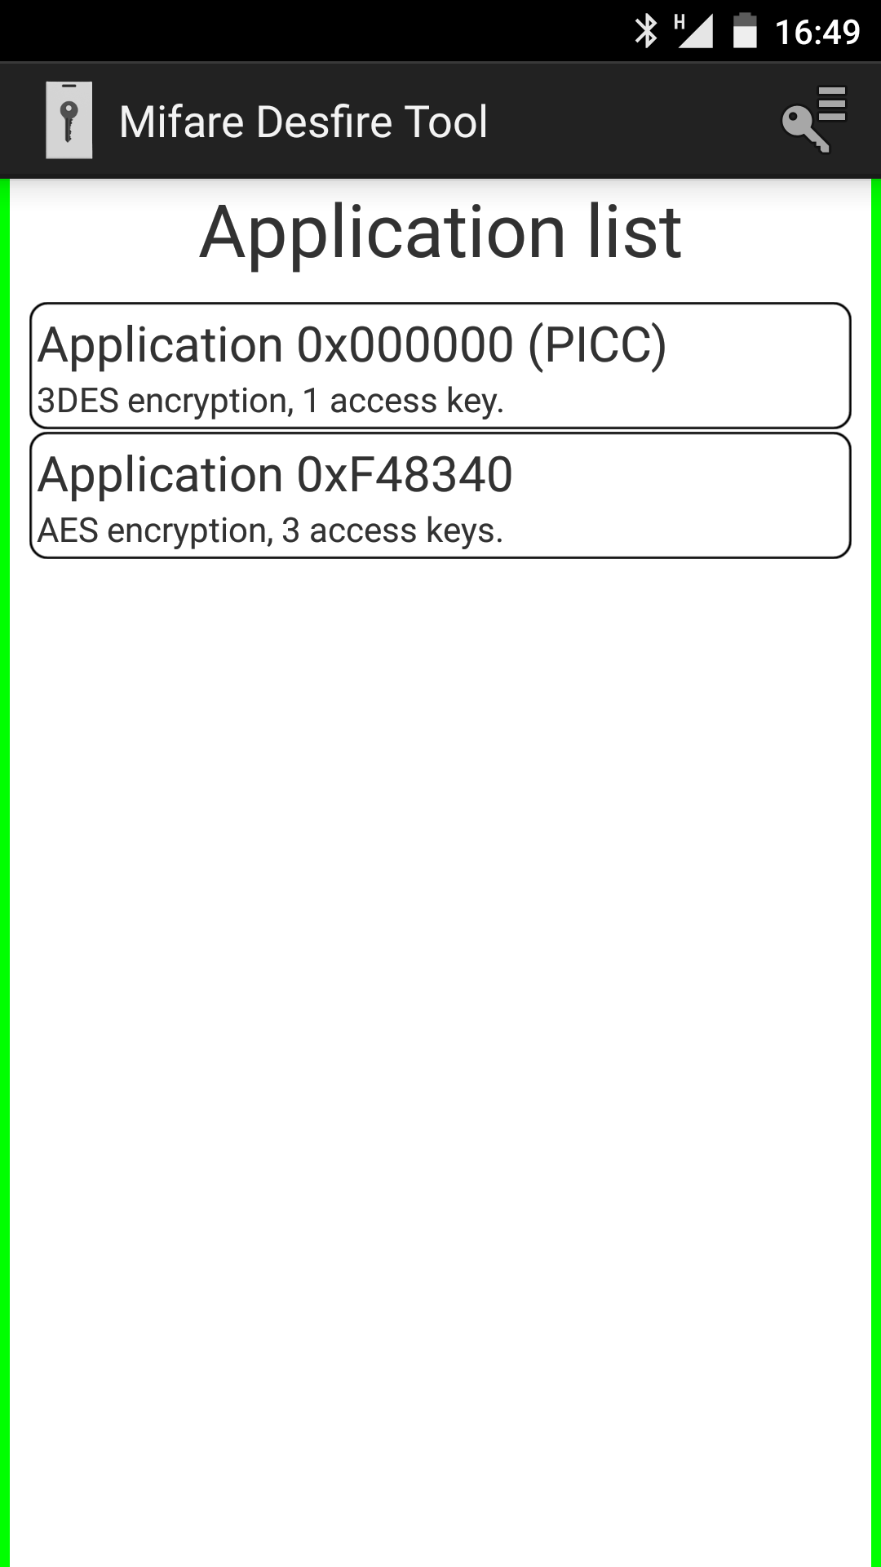
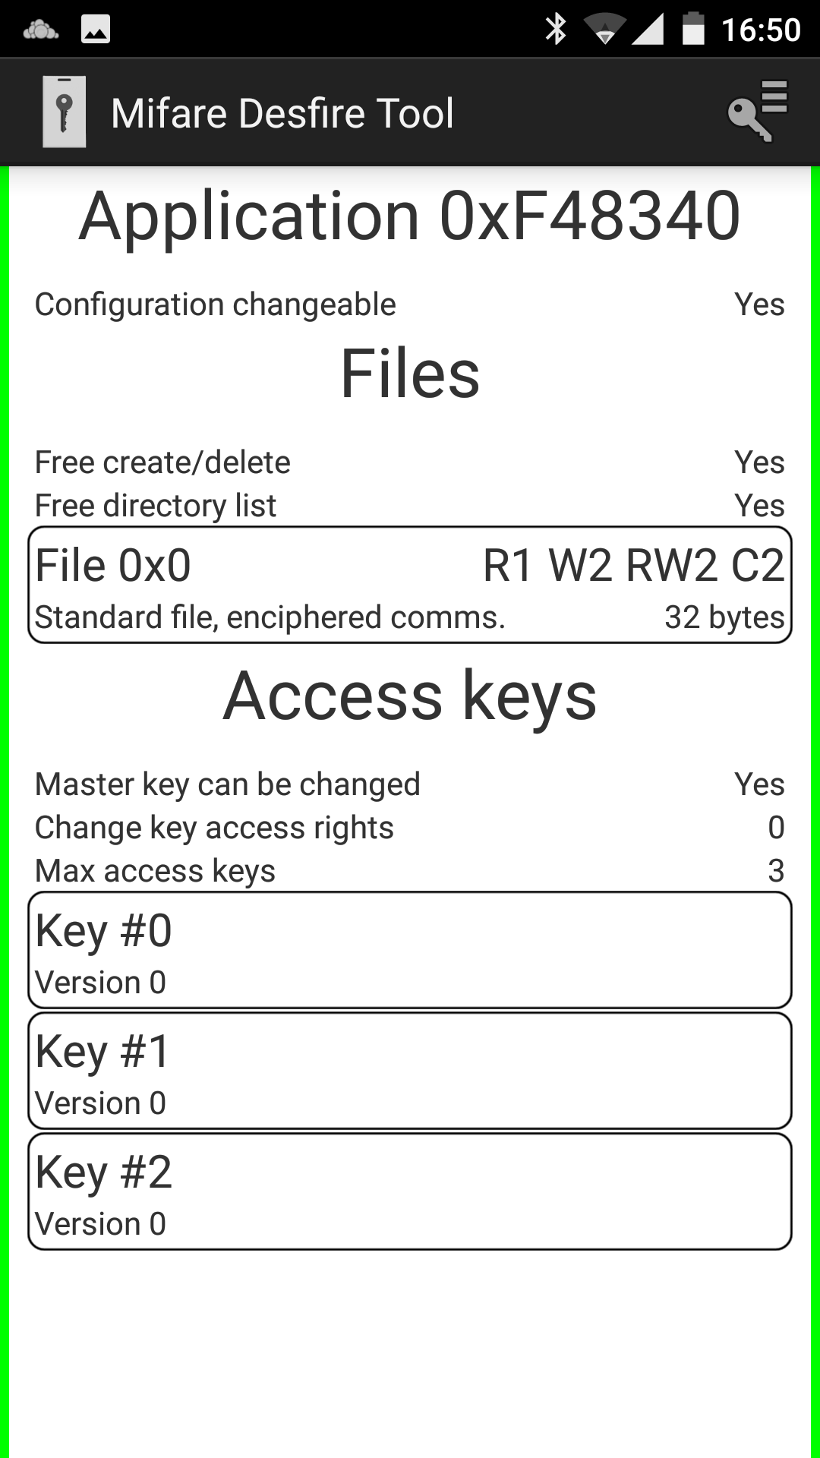
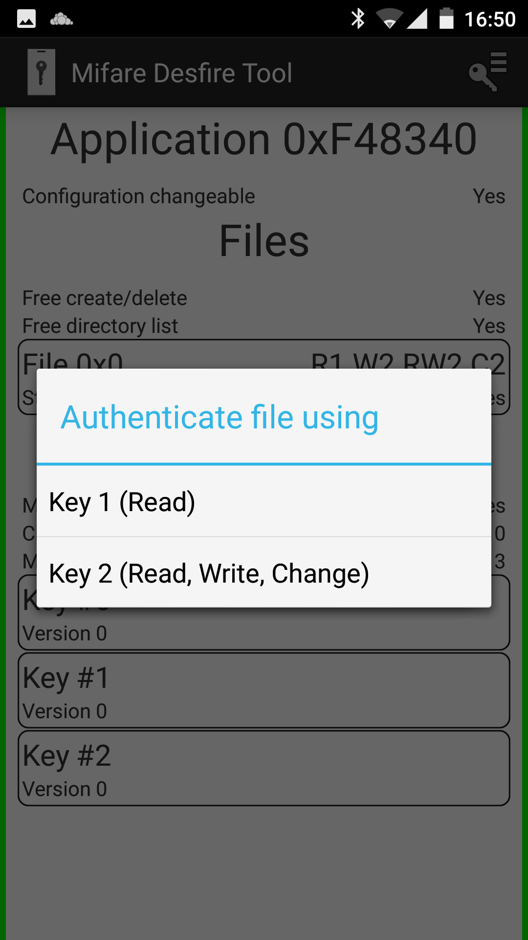
Introduction to NFC technologies: Desfire directory/file structure

Slide 11

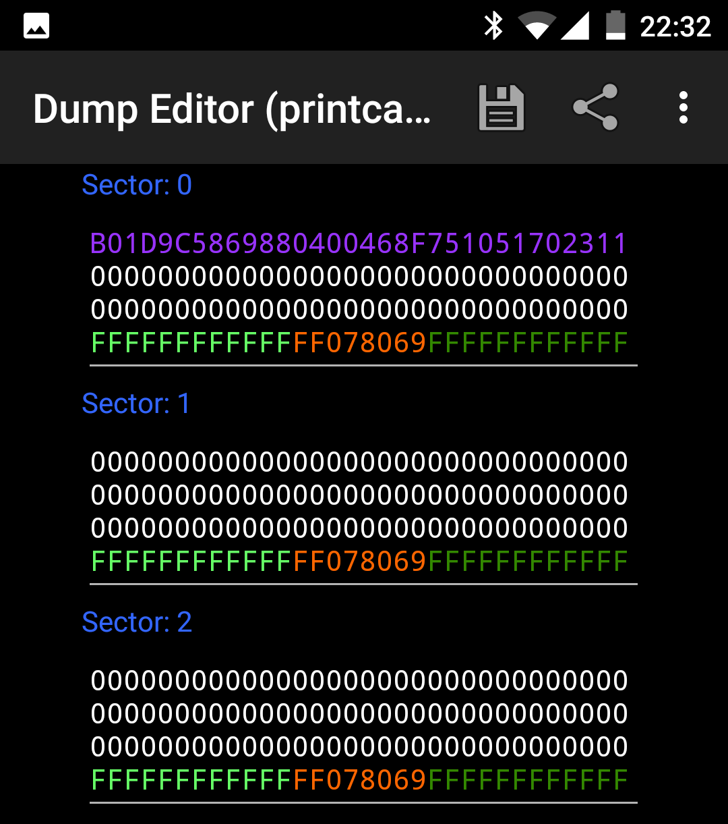
Introduction to NFC technologies: Access control
Authentication in NFC access control
UID based
Can be reconfigured on specific android devices with broadcom chipsets (Nexus 4)
Can be brute forced as companies buy cards in batches
Notes:
UID based: easily cloned.
http://forum.xda-developers.com/nexus-s/development/rd-fixed-uid-host-card-emulation-t1782200/post28991392#post28991392
PN544: possibility

Slide 12
Introduction to NFC technologies: Access control
Authentication in NFC access control
Key based
Uses random UID (most of the time)
Both sides need to have the application key in order to authenticate and setup session
Get Application IDs
-> 6a
<- 00
Select PICC application
-> 5a 00 00 00 (select master application AID)
<- 00
Authenticate with key 0 against selected application
-> 0A 00 (legacy auth - only 3K3DES or DES keys)
<- af a2 be cd 03 d8 46 cb 33 (enc random B)
-> af b0 cc bc ed 8f c8 38 c9 08 dc e2 4d 86 ca ec 3c (enc random B’ + enc random A)
<- 00 76 73 d9 49 71 3f f2 d1 (enc random A’)
Session key is now known at both sides. Communication will continue according to settings for the file authenticated to

Slide 13
Status of NFC on Android: modes of interaction
Different reader modes in Android
Active mode
Phone is used as a reader and initiates the connection. standard mode for reading tags.
Peer-to-Peer (P2P).
This mode is the one that has been advertised most by Google.
WIll allow to exchange NDEF messages (share contacts, apps, etc)
Card emulation
secure element wired to the NFC Controller (eg Nexus 4, Nexus 7)
would self destroy after several failed auth. attemps (cfr atm card)
separate secure ‘system’, like a smartcard
can run javacard applets (JCOP 2.2)
required special access keys to install applications through GP
first version of google wallet
Host card emulation
phone acts as a tag or badge
security is thrown out of the window
can pass data exchange directly to android app
two types of host card emulation
Notes:
http://stackoverflow.com/questions/20055497/emulate-mifare-card-with-android-4-4

Slide 14
Status of NFC on Android: modes of interaction
Different reader modes in Android
Active mode
Phone is used as a reader and initiates the connection. standard mode for reading tags.
Peer-to-Peer (P2P).
This mode is the one that has been advertised most by Google.
WIll allow to exchange NDEF messages (share contacts, apps, etc)
Card emulation
secure element wired to the NFC Controller (eg Nexus 4, Nexus 7)
would self destroy after several failed auth. attemps (cfr atm card)
separate secure ‘system’, like a smartcard
can run javacard applets (JCOP 2.2)
required special access keys to install applications through GP
first version of google wallet
Host card emulation
phone acts as a tag or badge
security is thrown out of the window
can pass data exchange directly to android app
two types of host card emulation
Notes:
http://stackoverflow.com/questions/20055497/emulate-mifare-card-with-android-4-4

Slide 15
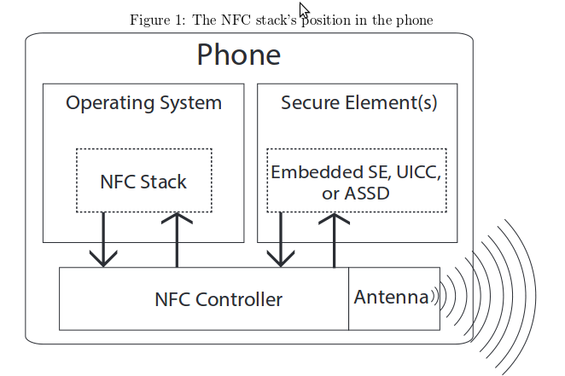
Status of NFC on Android: card emulation

Slide 16
Status of nfc on Android: Host card emulation
Standard Android host card emulation (4.4)
Hard to integrate with existing systems
AID routing, ..
Desfire PCDs working with ISO protocol (full APDUs required)
Not supported on AOSP for some chipsets
Broadcom based controllers are supported in AOSP (Nexus 4, Nexus 7, Galaxy S3)
NXP 544 based controllers are not supported in AOSP (Htc One)
Patch in Cyanogenmod 9 by Doug Yeager
Allows to send/receive raw bytes to an nfc reader
Only works for PN544 chipset (present in HTC One)
Theoretically supports all DesFire communication modes (native, wrapped, ISO)
Modify byte values that identify the card to the reader (ATQA, SAK)
Anti collision request handled by native code
Patch contains source code for three different modules in android

Slide 17
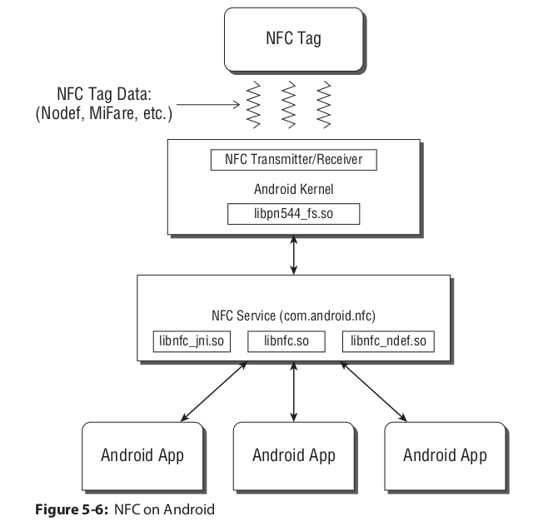
POC Presentation
Notes:
the patch adds configuration for the nfc controller
patches for the jni libraries to push the data into the new tag types. Android Manifest needs to register and listen to IsoPcdA.java

Slide 18
Status of NFC on Android: host card emulation
Reapplied this patch on top of the latest Cyanogenmod 12.1 (and working!)
Lack of documentation for the nfc controllers
No complete firmware manual to be found for PN544 (only under NDA)
Found quite some NXP copyrighted code in the Cyanogenmod patch
Special features can be enabled by loading a config file into the controller’s EEPROM (nfc_hw.c file)
Most of the register addresses are unknown
Disabling parity checks on the frame bytes would be nice (mfoc attack)
Disassembling pn544_fw.so firmware could be an option
Currently most of the open source tools exists for NXP’s pn532
The only nfc controller thas has a publicly available manual (instruction set) available
Good support in libnfc, libfreefare and other tools
Handy to test new functionality in the app
Notes:
http://stackoverflow.com/questions/20055497/emulate-mifare-card-with-android-4-4

Slide 19
POC Presentation: Building a custom NFC App
Build an app to communicate with the readers at Capgemini
Need to access a custom, hidden API in the patched Android framework jar
Can’t compile against these types, unless we rebuild the android sdk ourselves
Solved by using reflection to get the right tag type at runtime
Communication was initially only possible in a foreground thread
Based on previous work of a dutch student’s thesis (Kevin Valk)
Need to emulate the complete Desfire Protocol in software (in the app)
Opensource legacy protocol implementation for JavaCard (done at KULeuven)
Could be installed on a secure element in older devices, if cardmanager keys are known
For newer devices: transplant code to integrate with the previous framework
Adapt to support AES authentication for applications on the DesFire card
Creating applications on the card requires quite some functionality
Keys for existing application might be imported directly
nice to have a working whole more quickly
No official documentation on how DesFire protocol works (NDA)
mostly used the code in libfreefare as a reference
Notes:
http://stackoverflow.com/questions/20055497/emulate-mifare-card-with-android-4-4

Slide 20
POC Presentation: Building a custom NFC App
Implement basic get version in the app command as proof of concept
Tag detection in libfreefare (demo)
tag detection was done through SAK/ATQA + ATS values.
these values were adapt in lbnfc-xp to represent those of a DesFire card
proposed a patch to libfreefare to improve this (pr still pending)
Currently WIP is authentication against a DesFire application for newer versions
Implementation for session key generation is done
Currently app is built to work with wrapped protocol
WIP to enable key / application creation on the app
Communication log below
Reader tries to select application 0x40 0x83 0XF4 (see previous screenshots)
I/AppletThread(28626): -> 5A 40 83 F4
I/AppletThread(28626): <- 6D 00

Slide 21
Possibilities for the future
App could store all access conditions in the cloud
enable central management of the building’s physical security in a secured backend
advantage in case someone loses his card (access can be blocked from a central system)
could be good to sell as an add on to existing physical access systems
card keys could be stored in the cloud if response time is fast enough
find a way to install the app on regular devices (without root?)

Slide 22
References
Android Hacker’s handbook (Joshua J. Drake, Wiley, 2014)
Setting fixed UID for pn544 - http://forum.xda-developers.com/nexus-s/development/rd-fixed-uid-host-card-emulation-t1782200/post28991392#post28991392
MIfare communication example - https://ridrix.wordpress.com/2009/09/19/mifare-desfire-communication-example/
Android HCE framework - https://github.com/kevinvalk/android-hce-framework
desfire-javacard-emulation - https://securewww.esat.kuleuven.be/cosic/publications/article-2206.pdf
Android explorations - http://nelenkov.blogspot.be/
Android host card emulation with ACR-122U - http://blog.opendatalab.de/hack/2013/11/07/android-host-card-emulation-with-acr122/
Host card emulation on AOSP pn544 - http://forum.xda-developers.com/showthread.php?t=2573842
Cyanogenmod PN544 HCE patches - https://github.com/jekkos/
Libfreefare Cyanogenmod tag detection patches - https://github.com/jekkos/libfreefare
nfc-tools iso14443-A - http://nfc-tools.org/index.php?title=ISO14443A

